Slide 1
Building Android apps – Week 11a
2843-201710_MCS4993_M:Topics in MA/CS
2843-201710_MCS5993_M:Topics in Computer Science

Slide 2
Agenda
Design Patterns

Slide 3
What is Your Goal?
Scalable
Maintainable
Testable

Slide 4
What is Your Goal?
Scalable
Add new features quickly
Maintainable
No spaghetti code
Don’t cross the streams
Testable
Easy to unit test

Slide 5
Why?
Easier to add new features
Easier to understand
Easier to police
Make our life easier
Make Unit Testing easier

Slide 6
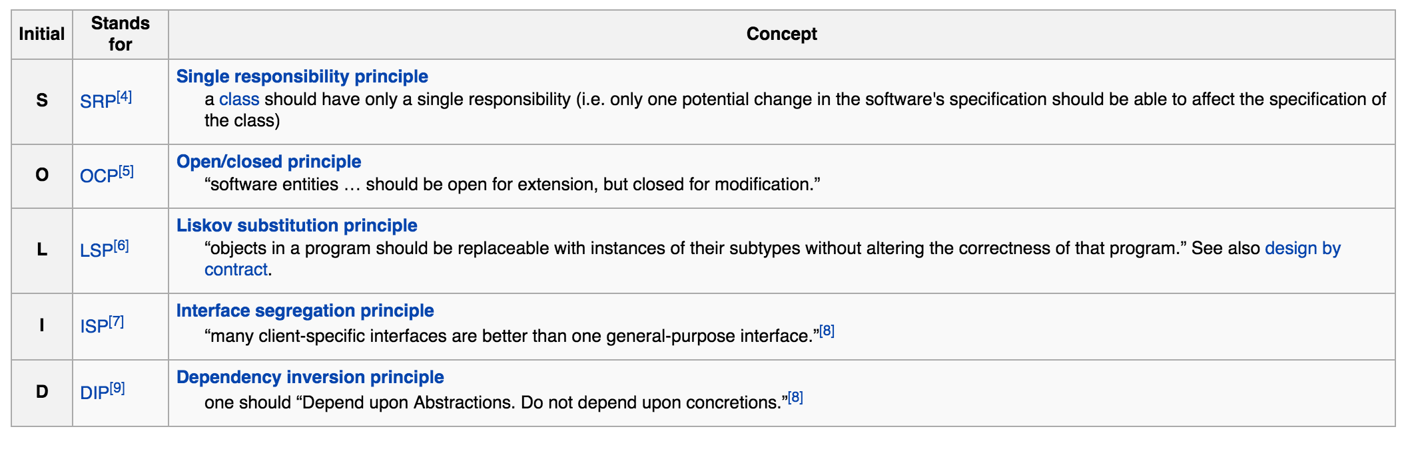
How Do We Get There?
Notes:
https://en.wikipedia.org/wiki/SOLID_(object-oriented_design)
LSP - Functions that use pointers or references to base classes must be able to use objects of derived classes without knowing it.
if every time you call Foo on a Derived object, it gives exactly the same results as calling Foo on a Base object, as long as arg is the same.
The interface-segregation principle (ISP) states that no client should be forced to depend on methods it does not use. ISP splits interfaces that are very large into smaller and more specific ones so that clients will only have to know about the methods that are of interest to them.
Xerox had created a new printer system that could perform a variety of tasks such as stapling and faxing. The software for this system was created from the ground up. As the software grew, making modifications became more and more difficult so that even the smallest change would take a redeployment cycle of an hour, which made development nearly impossible.
The design problem was that a single Job class was used by almost all of the tasks. Whenever a print job or a stapling job needed to be performed, a call was made to the Job class. This resulted in a 'fat' class with multitudes of methods specific to a variety of different clients. Because of this design, a staple job would know about all the methods of the print job, even though there was no use for them.

Slide 7
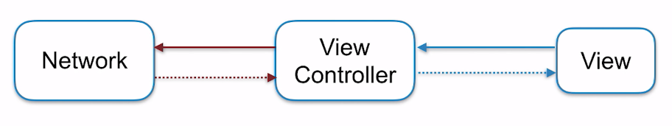
Classic Android

Slide 8
Classic Android
Pros
Better the devil you know
Cons
Activities and Fragments quickly become large
Painful to make changes or add new features
All the logic in Activities, unit testing is impossible
Classic Android is not MVC

Slide 9
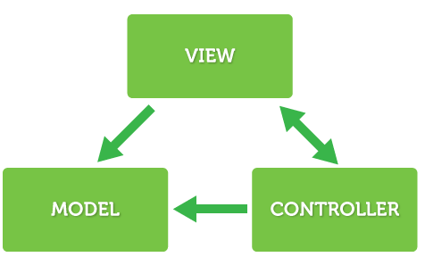
MVC

Slide 10
MVC
Model
Data to be presented, retrieved from a file, database or web service
View
Presentation layer, including screens, menus, buttons and text labels
Controller
Software that ties the model and view together, without creating dependencies between them

Slide 11
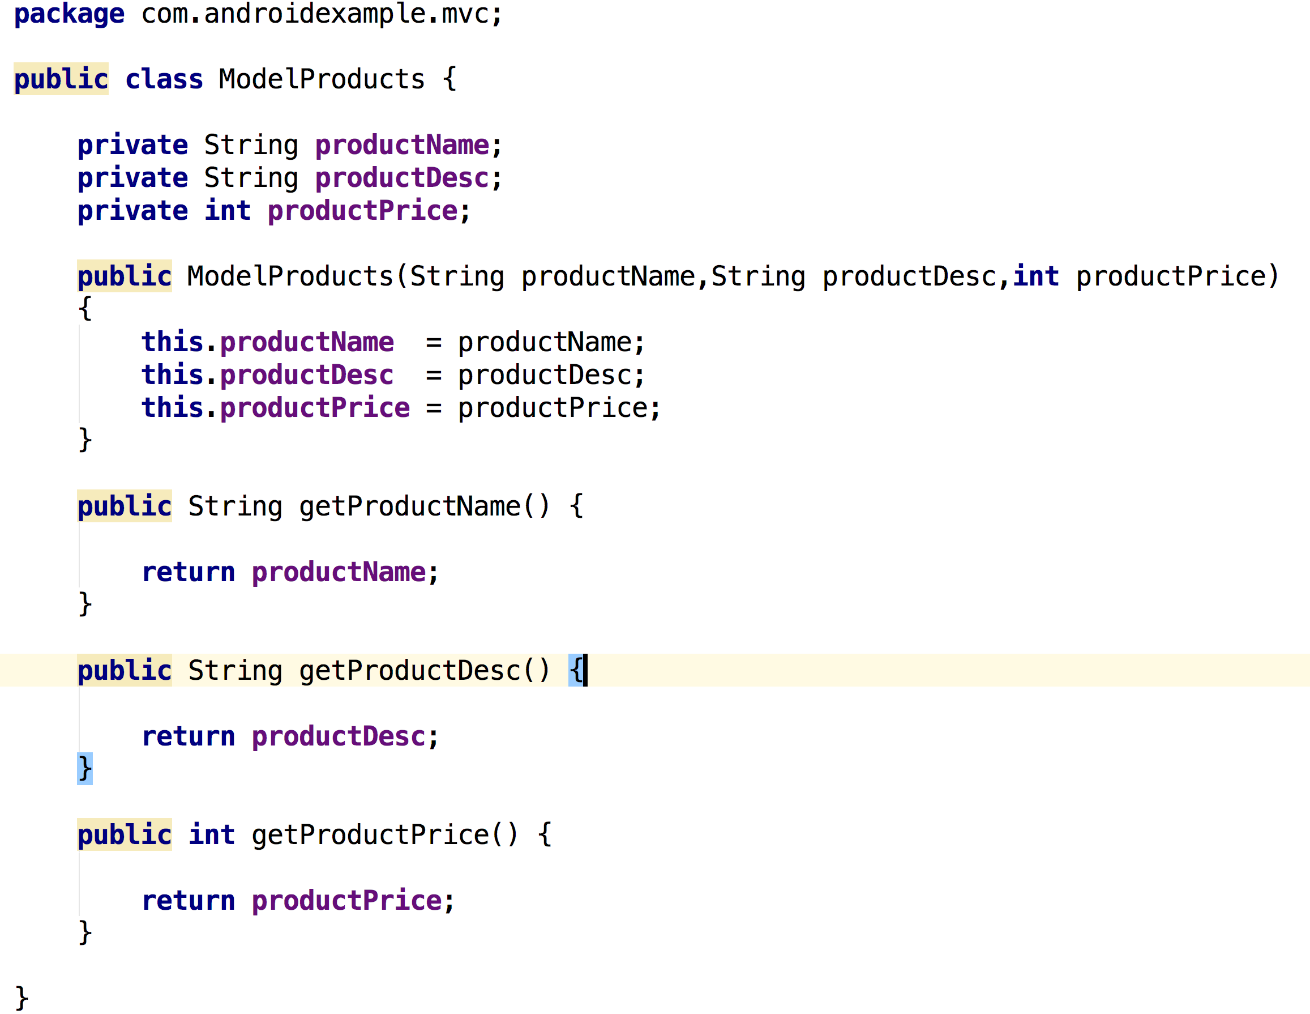
Notes:
SHOW APP!!

Slide 12
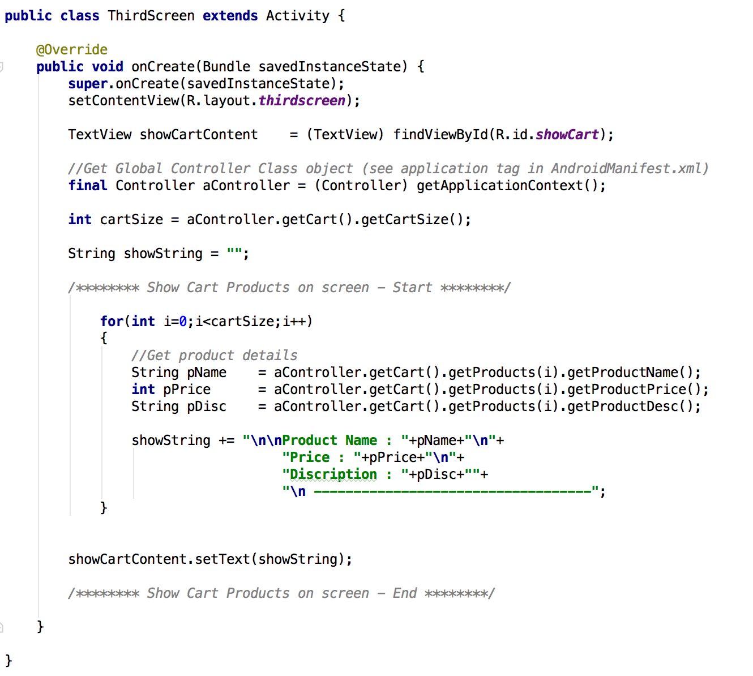
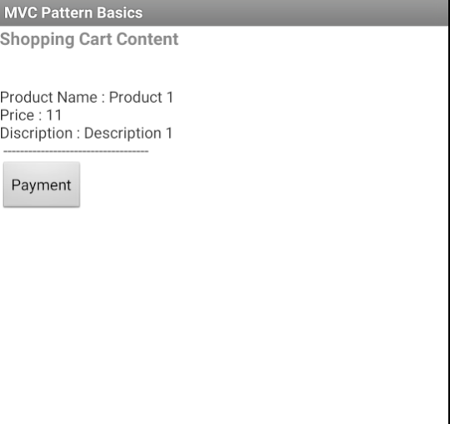

Slide 13
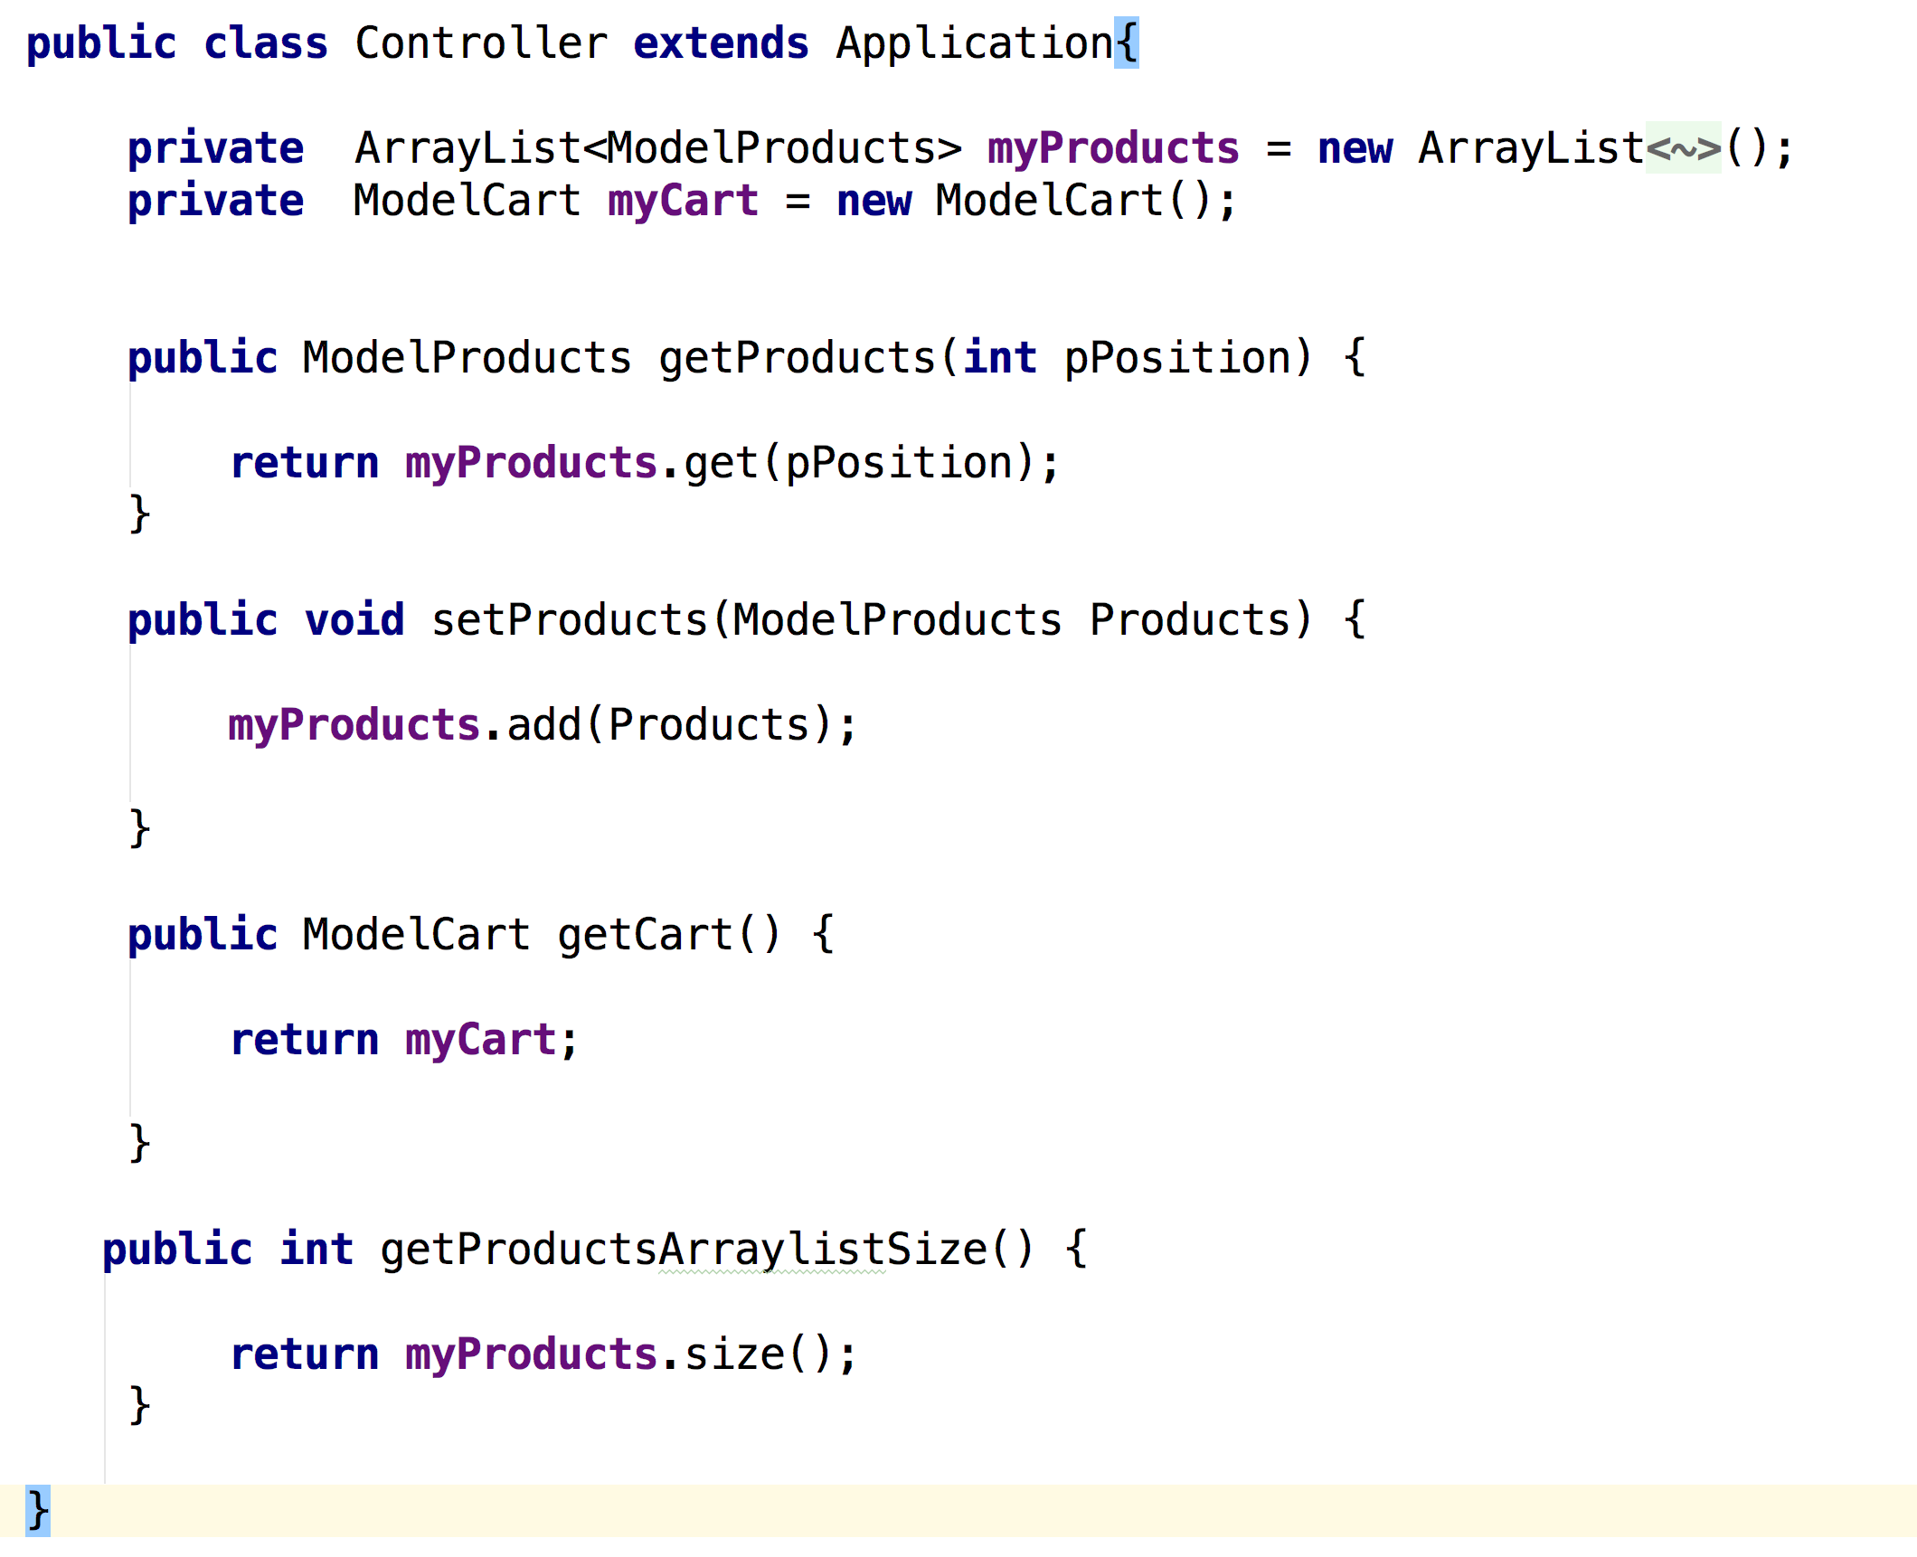

Slide 14
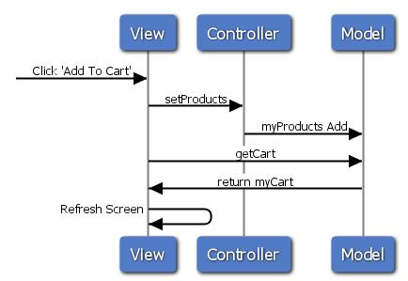
Notes:
the getCart and return myCart calls go though the Controller.

Slide 15
MVC
Pros
No business logic in UI
Easier to unit test
Cons
Doesn't scale, separates UI but not model
Controller often grows too big

Slide 16
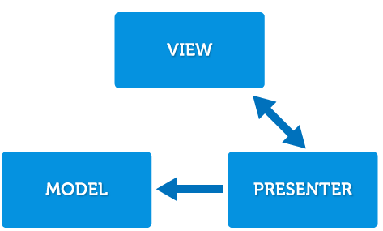
MVP

Slide 17
MVP
Increases separation of concerns into 3 layers
Passive View - Render logic
Presenter - Handle User events (Proxy)
Model - Business logic

Slide 18
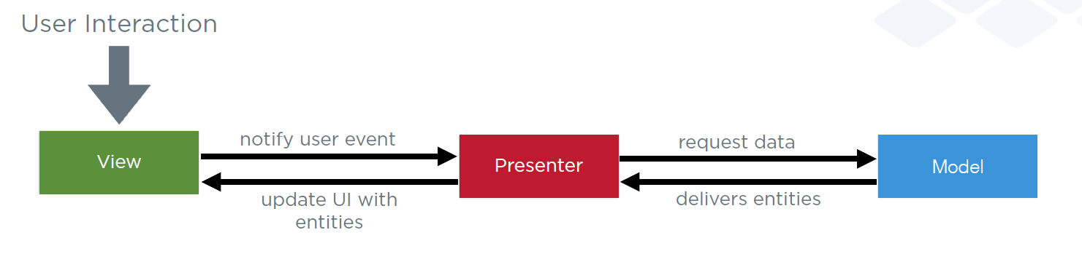
MVP

Slide 19
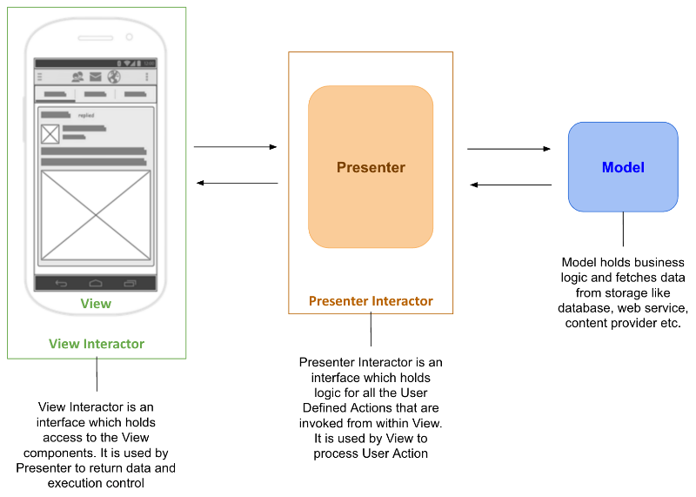

Slide 20
MVP
In MVP, the View cannot access the Model.
The Presenter is tied to a single View.
The View is completely passive in the MVP pattern.
Notes:
In the MVC pattern, the View layer is somewhat intelligent and can retrieve data directly from the Model. In the MVP pattern, the View is completely passive and data is always delivered to the View by the Presenter. Controllers in MVC can also be shared between multiple Views. In MVP, the View and the Presenter have a one-to-one relationship, therefore, the Presenter is tied to one View.

Slide 21
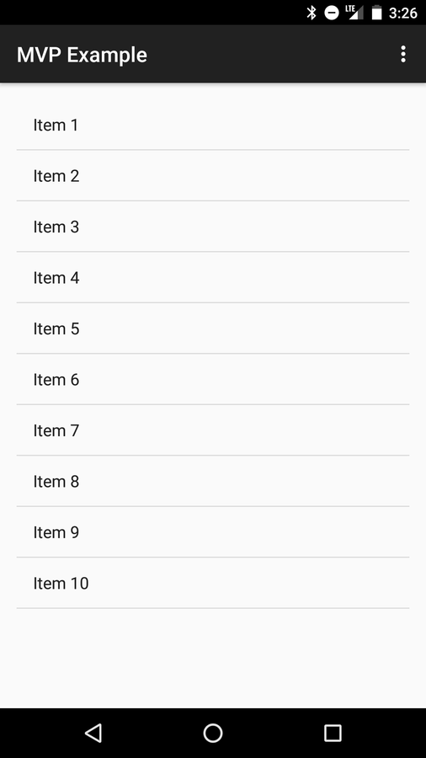
Notes:
SHOW IT

Slide 22
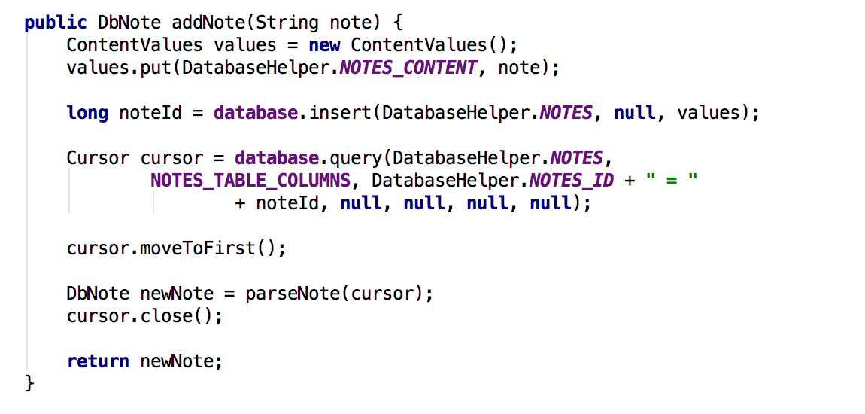
Notes:
Model

Slide 23
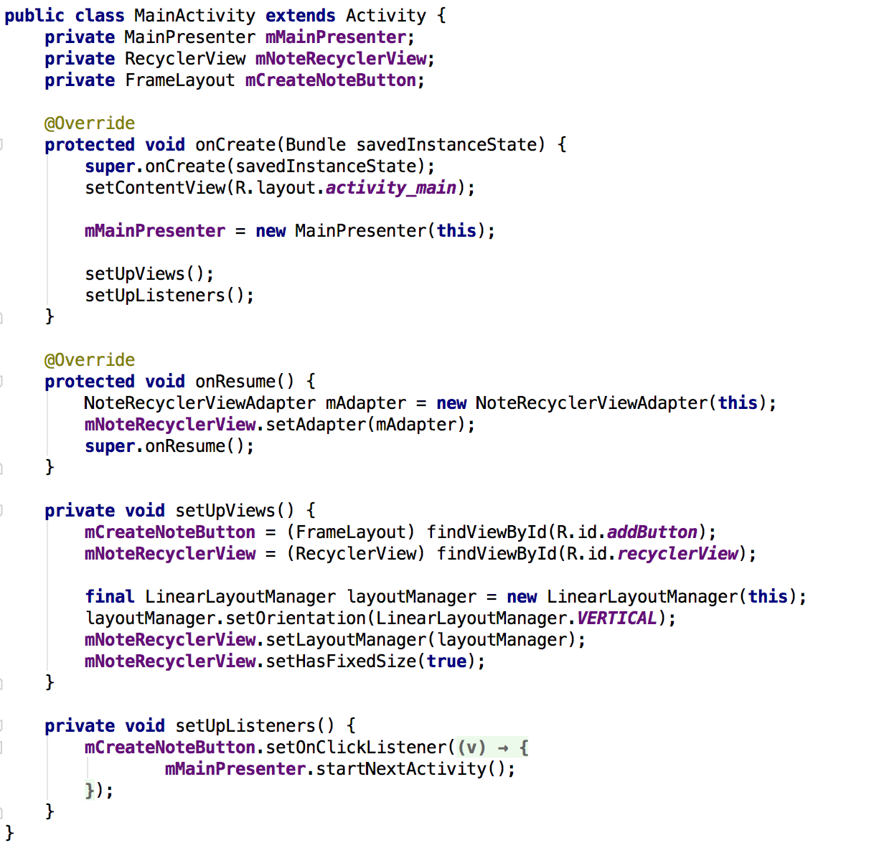
Notes:
View

Slide 24
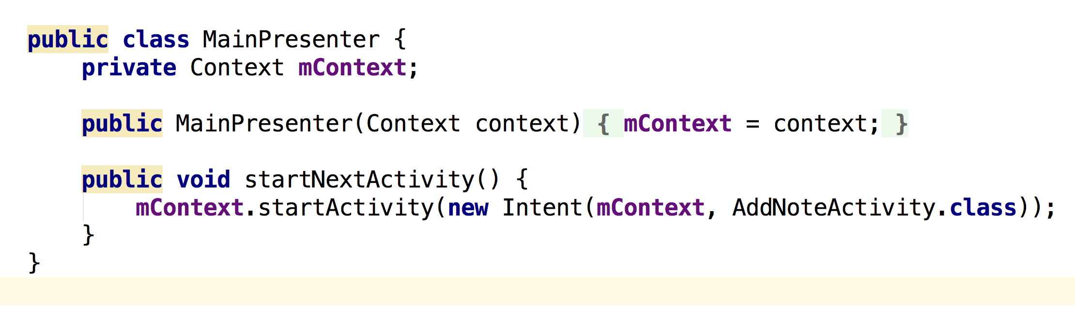
Notes:
Presenter

Slide 25
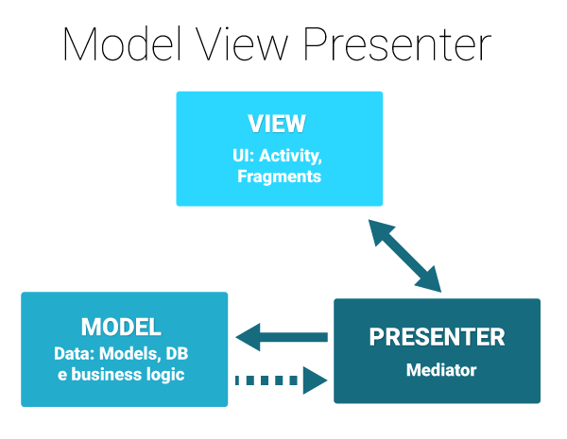

Slide 26
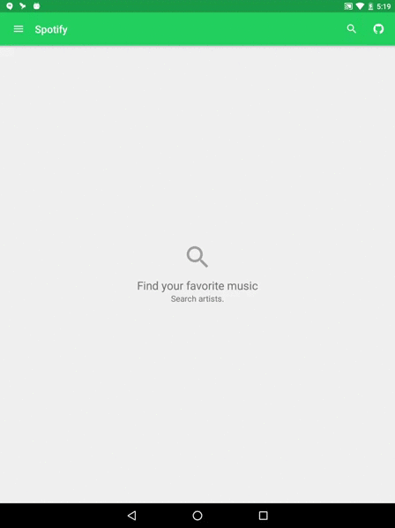
Notes:
https://github.com/erikcaffrey/Android-Spotify-MVP – SHOW IT - SHOW GITHUB CODE

Slide 27
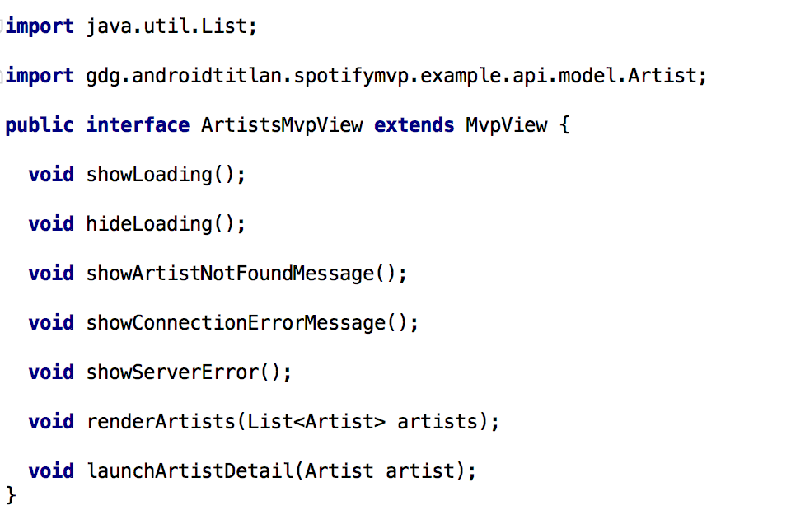
Notes:
Activity, Fragment, and View Objects
There are several interpretations of how MVP can be implemented on Android. In general, though, Activities and Fragments are assigned the role of View and are responsible for creating the Presenter and the Model. The View is also responsible for maintaining the Model and the Presenter between configuration changes, informing them about the eventual destruction of the View.

Slide 28
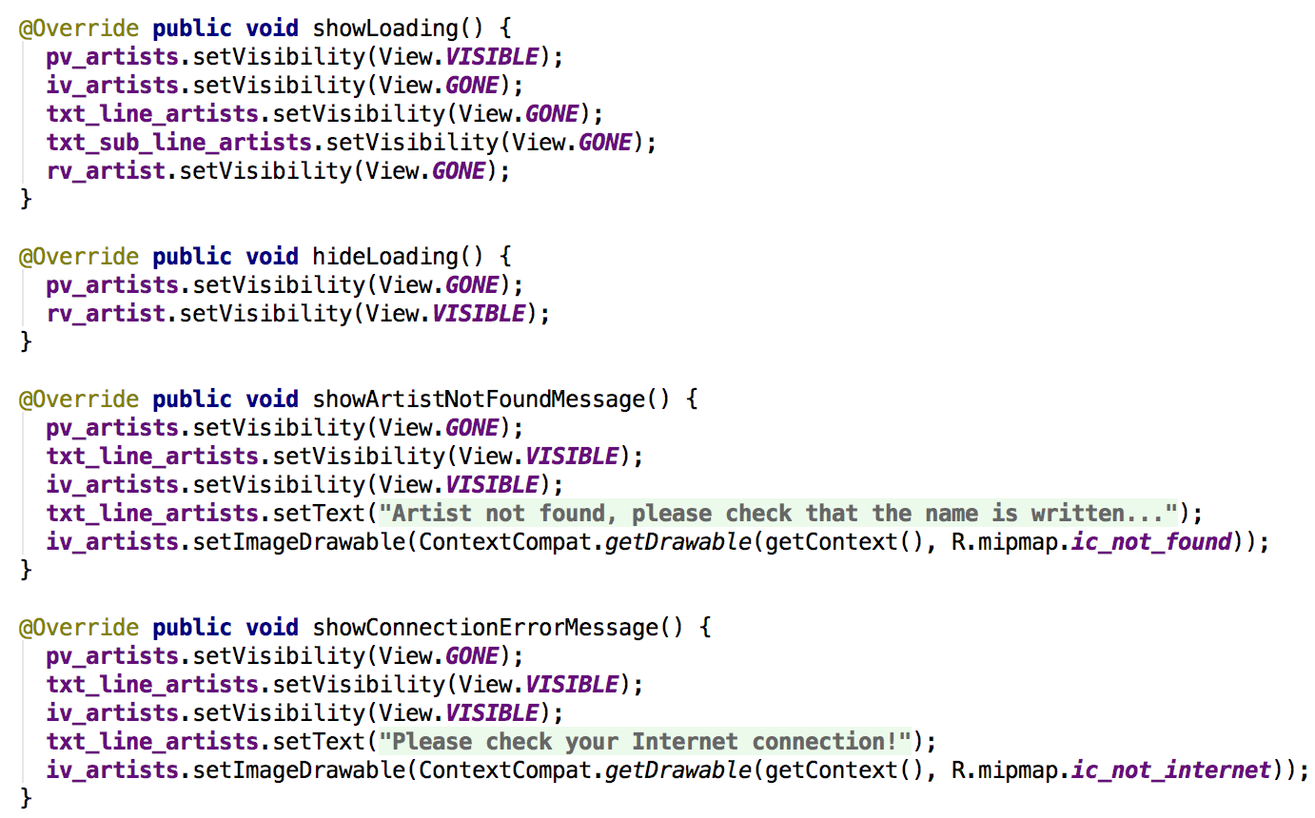
Notes:
spotifymvp/example/ui/fragment/ArtistsFragment.java

Slide 29
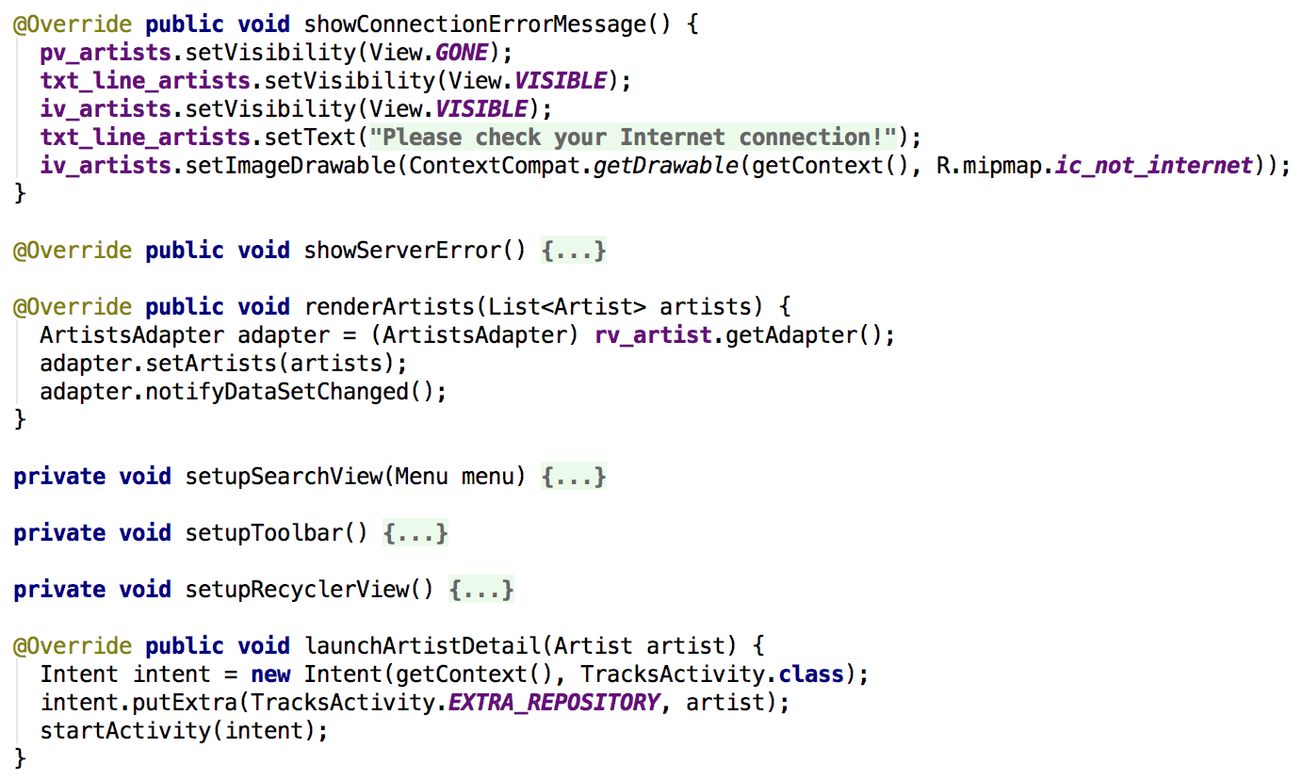
Notes:
More view implementation code

Slide 30
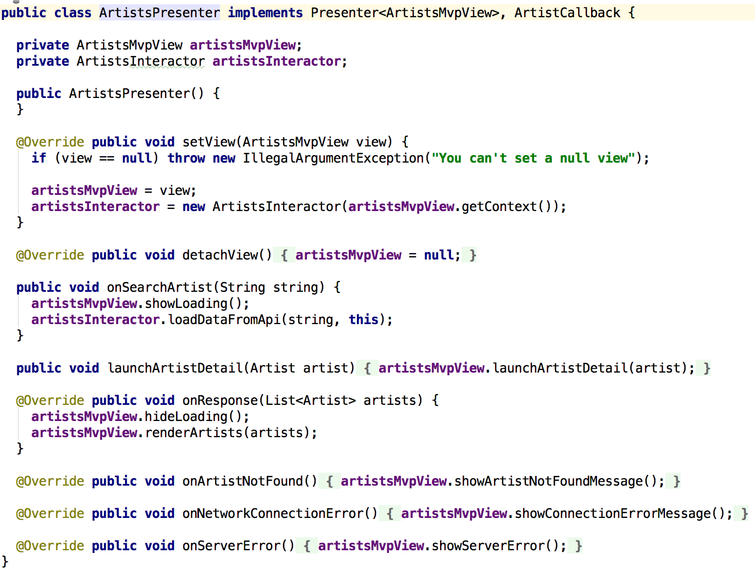
Notes:
PRESENTER

Slide 31
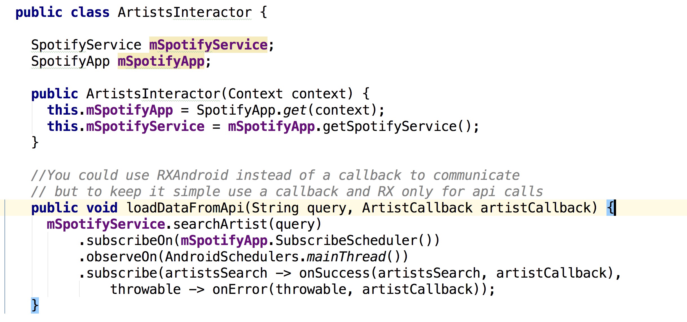
Notes:
Model – loading data from Spotify API – loadDataFromAPI

Slide 32
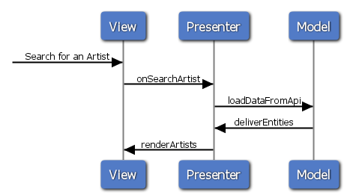

Slide 33
MVP Testing
View
Test render logic and interaction with presenter, mock Presenter.
Presenter
Test that view events invoke the right model method.
Mock both View and Model.
Model
Test the business logic, mock the data source and Presenter.

Slide 34
MVP
Pros
Complex Tasks split into simpler tasks
Smaller objects, less bugs, easier to debug
Testable
Cons
BoilerPlate to wire the layers.
Model can’t be reused, tied to specific use case.
View and Presenter are tied to data objects since they share the same type of object with the Model.

Slide 35
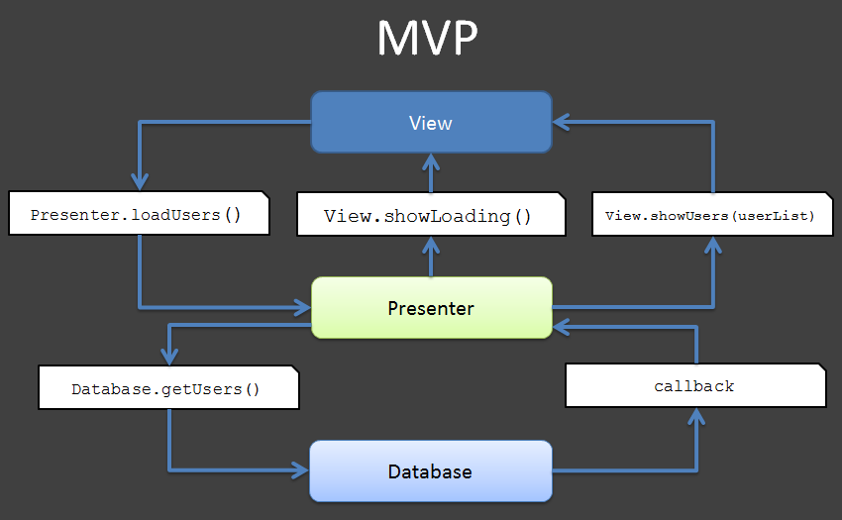

Slide 36
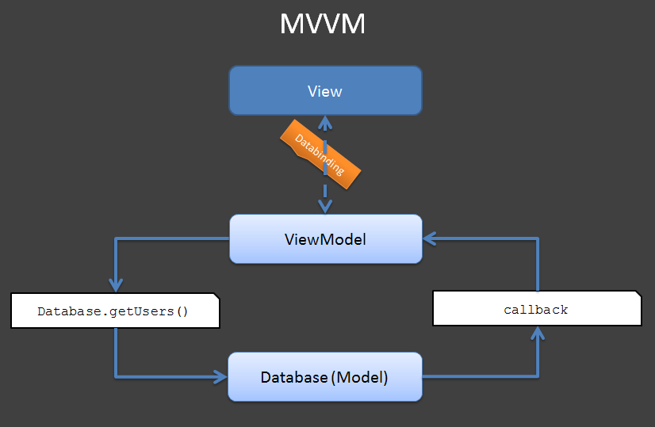

Slide 37
MVVM
Microsoft Pattern
Removes UI code from Activities/Fragments
View has no knowledge of model
Data Binding = Bind ViewModel to Layout
Goodbye Presenter, hello ViewModel

Slide 38
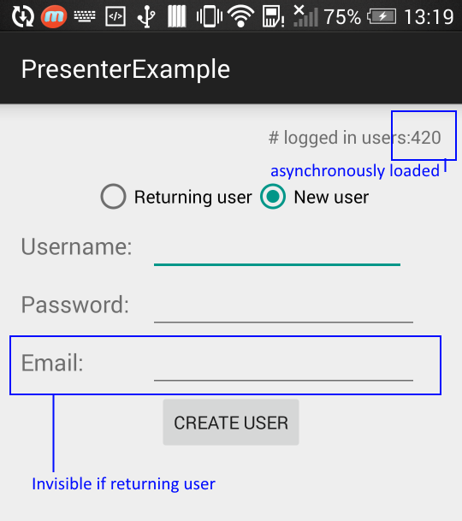
Notes:
SHOW IT

Slide 39
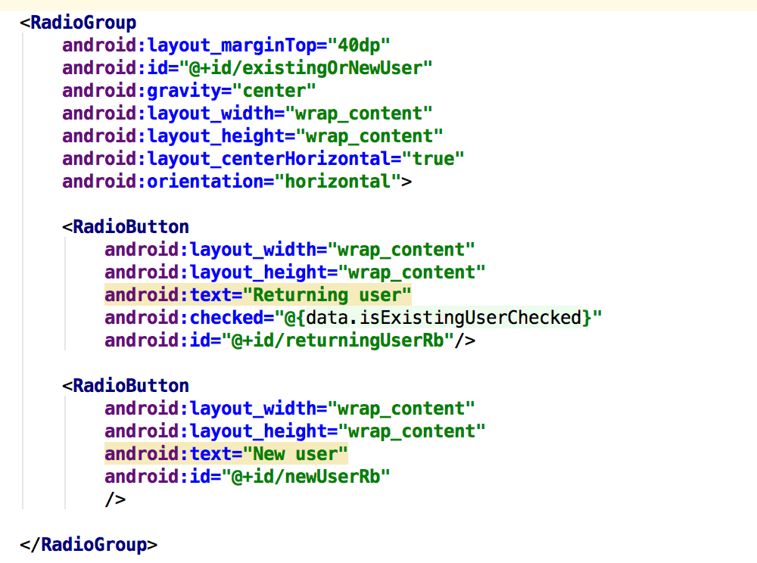
Notes:
Model

Slide 40
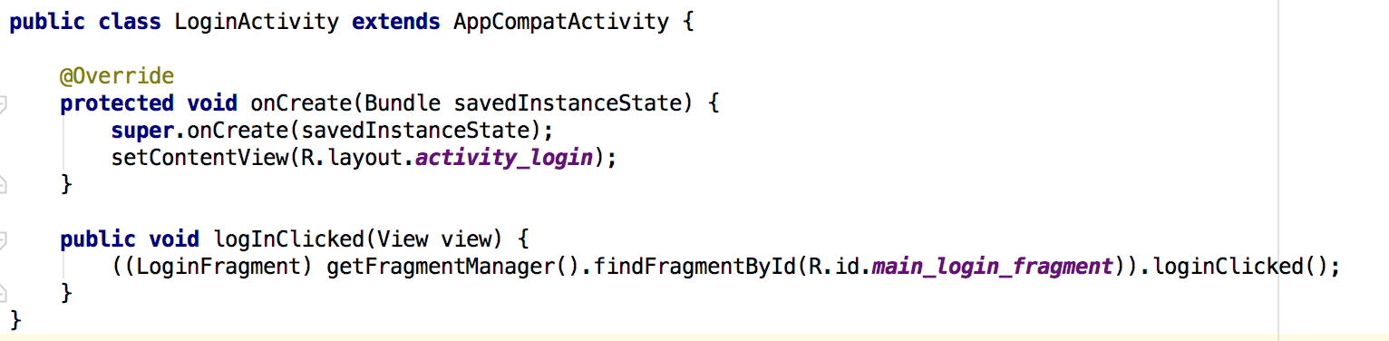

Slide 41
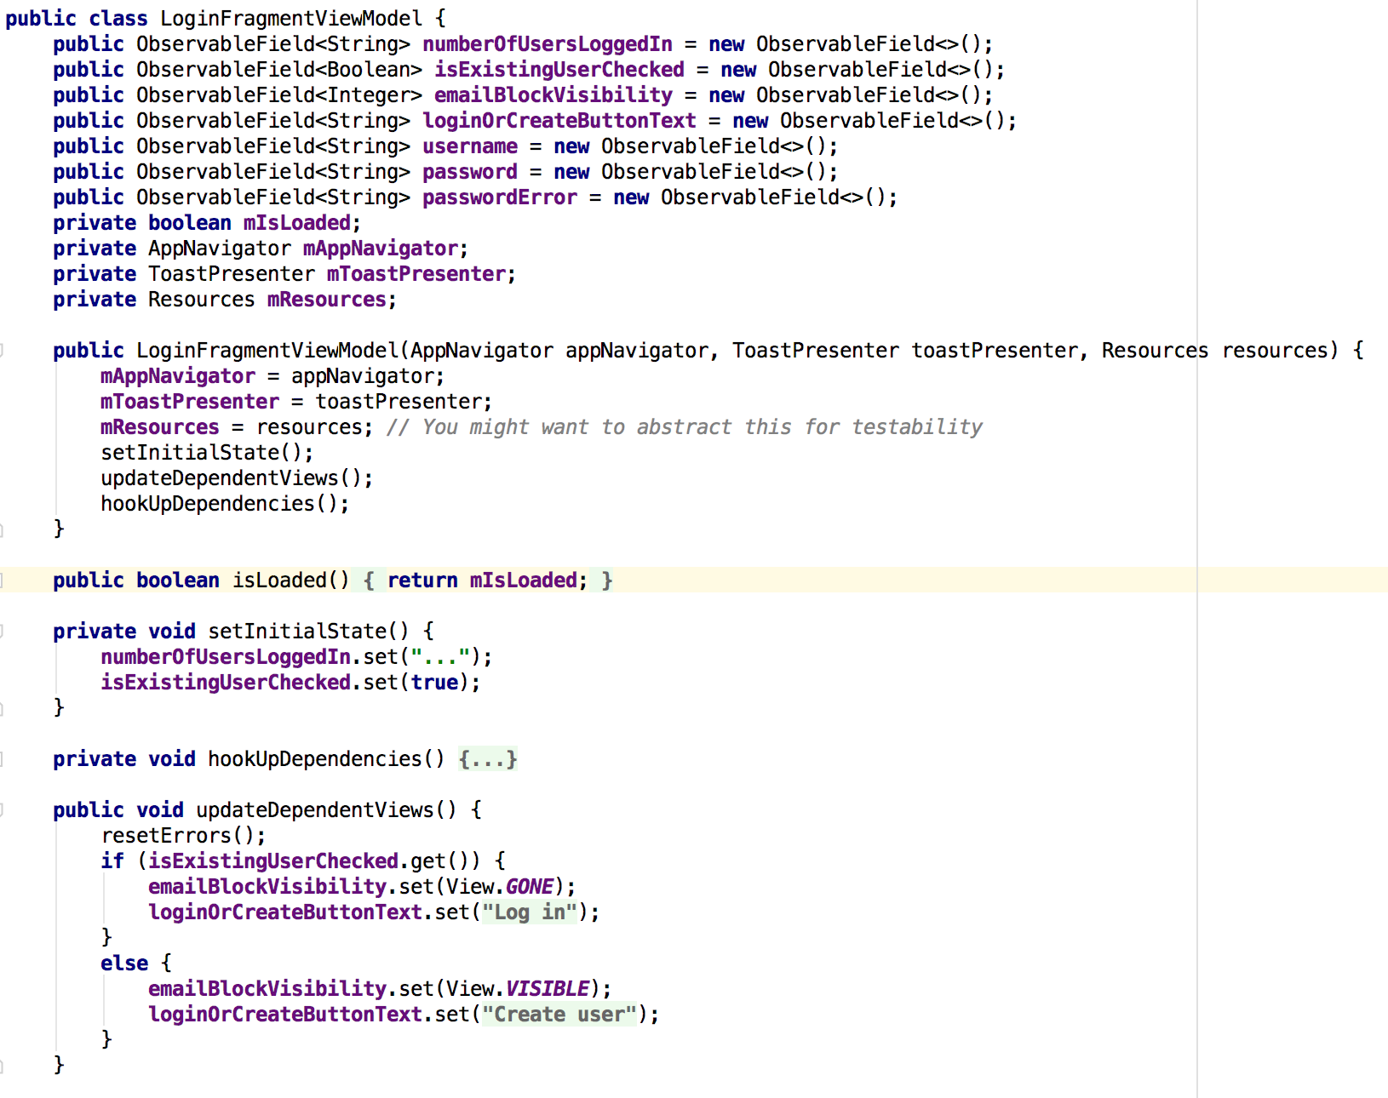
Notes:
ViewModel

Slide 42
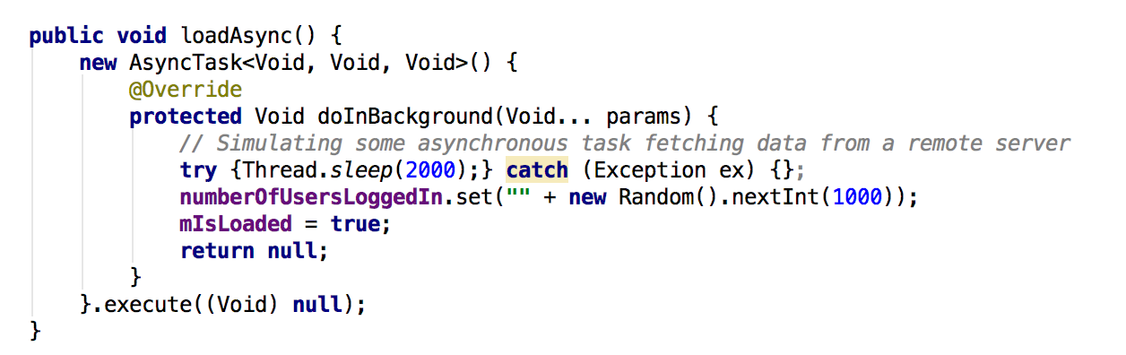
Notes:
No real model, just a simulation

Slide 43
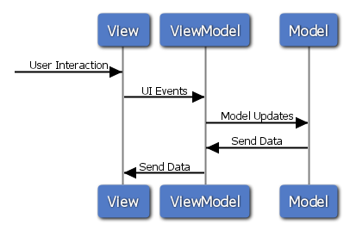

Slide 44
MVVM
Pros
First Party Library
Compile time checking
Presentation layer in XML
Testable
Less code, no more Butterknife
Cons
Data Binding isn't always appropriate
Android Studio integration was flaky

Slide 45
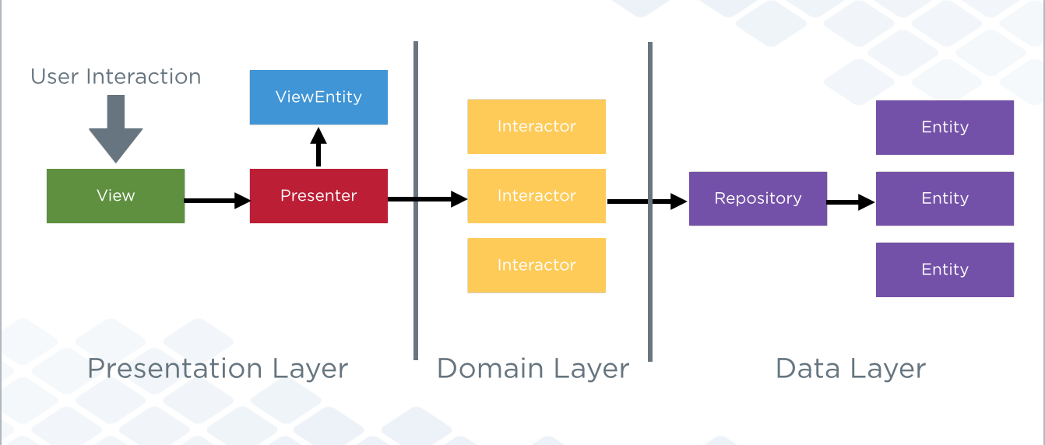
Clean
Notes:
https://www.youtube.com/watch?v=siD9Ll_D93s

Slide 46
Clean
Independent of Frameworks
Testable
Independent of UI
Independent of Database
Independent of any External Agency
Decoupled

Slide 47
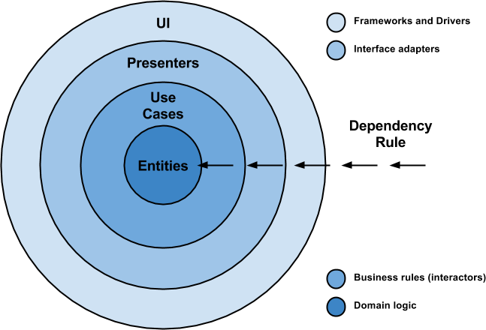
Notes:
Here is some vocabulary that is relevant for getting familiar and understanding this approach in a better way:
Entities: These are the business objects of the application.
Use Cases: These use cases orchestrate the flow of data to and from the entities. Are also called Interactors.
Interface Adapters: This set of adapters convert data from the format most convenient for the use cases and entities. Presenters and Controllers belong here.
Frameworks and Drivers: This is where all the details go: UI, tools, frameworks, etc.

Slide 48
Dependency Rule
“source code dependencies can only point inwards and nothing in an inner circle can know anything at all about something in an outer circle.”

Slide 49
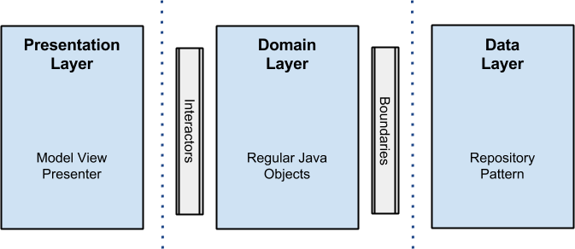
Notes:
The objective is the separation of concerns by keeping the business rules not knowing anything at all about the outside world, thus, they can can be tested without any dependency to any external element.
To achieve this, my proposal is about breaking up the project into 3 different layers, in which each one has its own purpose and works separately from the others.

Slide 50
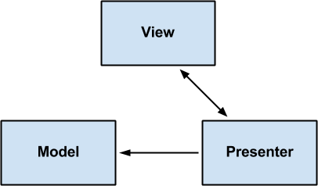
Presentation Layer
Notes:
Is here, where the logic related with views and animations happens. It uses no more than aModel View Presenter (MVP from now on), but you can use any other pattern like MVC or MVVM. I will not get into details on it, but here fragments and activities are only views, there is no logic inside them other than UI logic, and this is where all the rendering stuff takes place. Presenters in this layer are composed with interactors (use cases) that perform the job in a new thread outside the android UI thread, and come back using a callback with the data that will be rendered in the view.

Slide 51
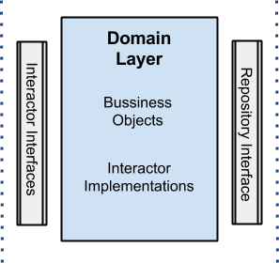
Domain Layer
Notes:
Business rules here: all the logic happens in this layer. Regarding the android project, you will see all the interactors (use cases) implementations here as well. This layer is a pure java module without any android dependencies. All the external components use interfaces when connecting to the business objects.

Slide 52
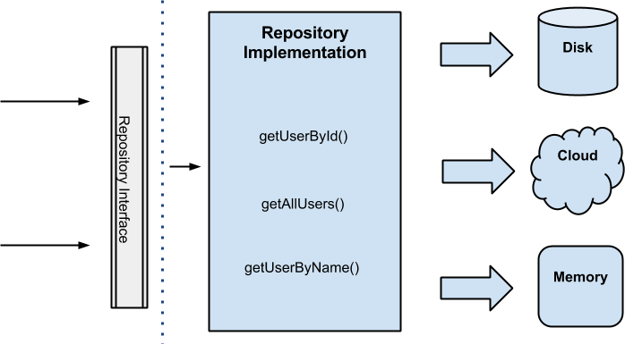
Data Layer
Notes:
All data needed for the application comes from this layer through a UserRepository implementation (the interface is in the domain layer) that uses a Repository Pattern with a strategy that, through a factory, picks different data sources depending on certain conditions. For instance, when getting a user by id, the disk cache data source will be selected if the user already exists in cache, otherwise the cloud will be queried to retrieve the data and later save it to the disk cache. The idea behind all this is that the data origin is transparent for the client, which does not care if the data is coming from memory, disk or the cloud, the only truth is that the data will arrive and will be got.

Slide 53
Simple Example
“Greet the user with a message when the app starts where that message is stored in the database.”
the presentation package
the storage package
the domain package
Notes:
https://medium.com/@dmilicic/a-detailed-guide-on-developing-android-apps-using-the-clean-architecture-pattern-d38d71e94029#.cvw2vjcr2

Slide 54
Summary of calls
MainActivity
->MainPresenter
-> WelcomingInteractor
-> WelcomeMessageRepository
-> WelcomingInteractor
-> MainPresenter
-> MainActivity

Slide 55
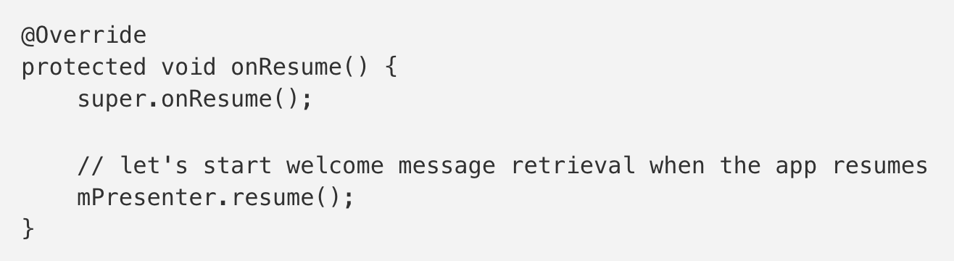
MainActivity
Notes:
So how and where do we start the Interactor when an app resumes? Everything that is not strictly view related should go into the Presenter class. This helps achieve separation of concerns and prevents the Activity classes from getting bloated. This includes all code working with Interactors.
In our MainActivity class we override the onResume() method:
All Presenter objects implement the resume() method when they extendBasePresenter.

Slide 56
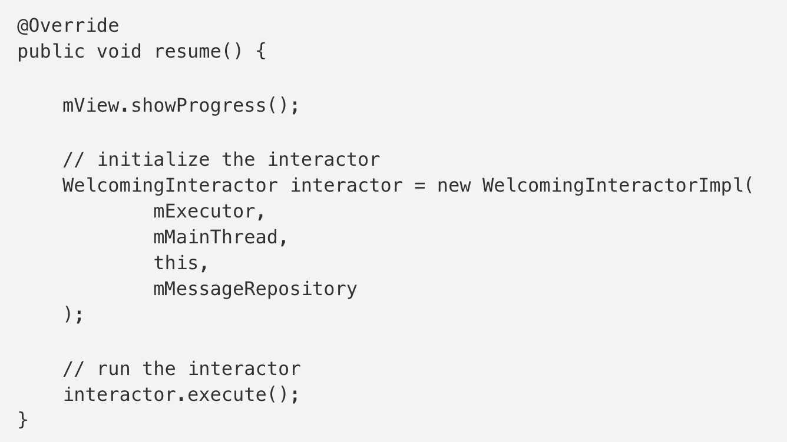
MainPresenter
Notes:
We start the Interactor inside the MainPresenter class in the resume()method:
The execute() method will just execute the run() method of theWelcomingInteractorImpl in a background thread.
The run() method can be seen in the Writing a new Interactor section.

Slide 57
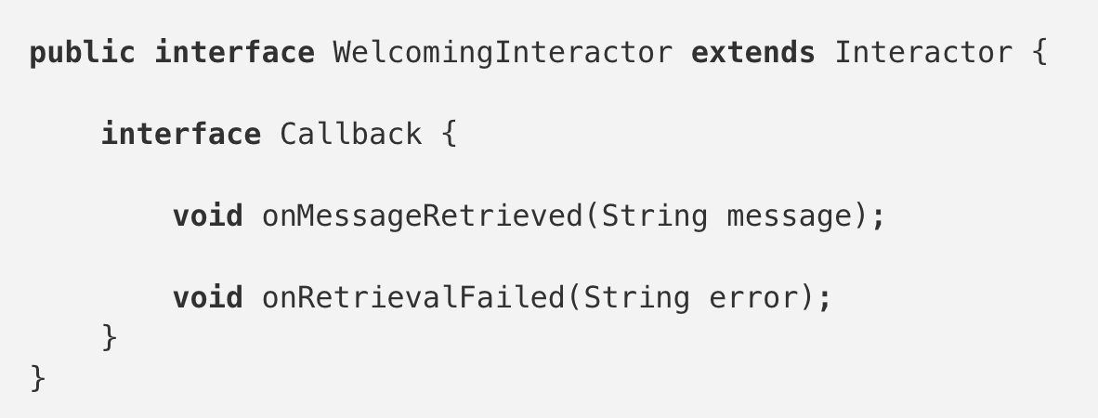
Writing a new Interactor
Notes:
All Interactors are run in the background thread so there shouldn’t be any impact on UI performance.
Let’s create a new Interactor with a warm name of WelcomingInteractor.
The Callback is responsible for talking to the UI on the main thread, we put it into this Interactor’s interface so we don’t have to name it a WelcomingInteractorCallback — to distinguish it from other callbacks.

Slide 58
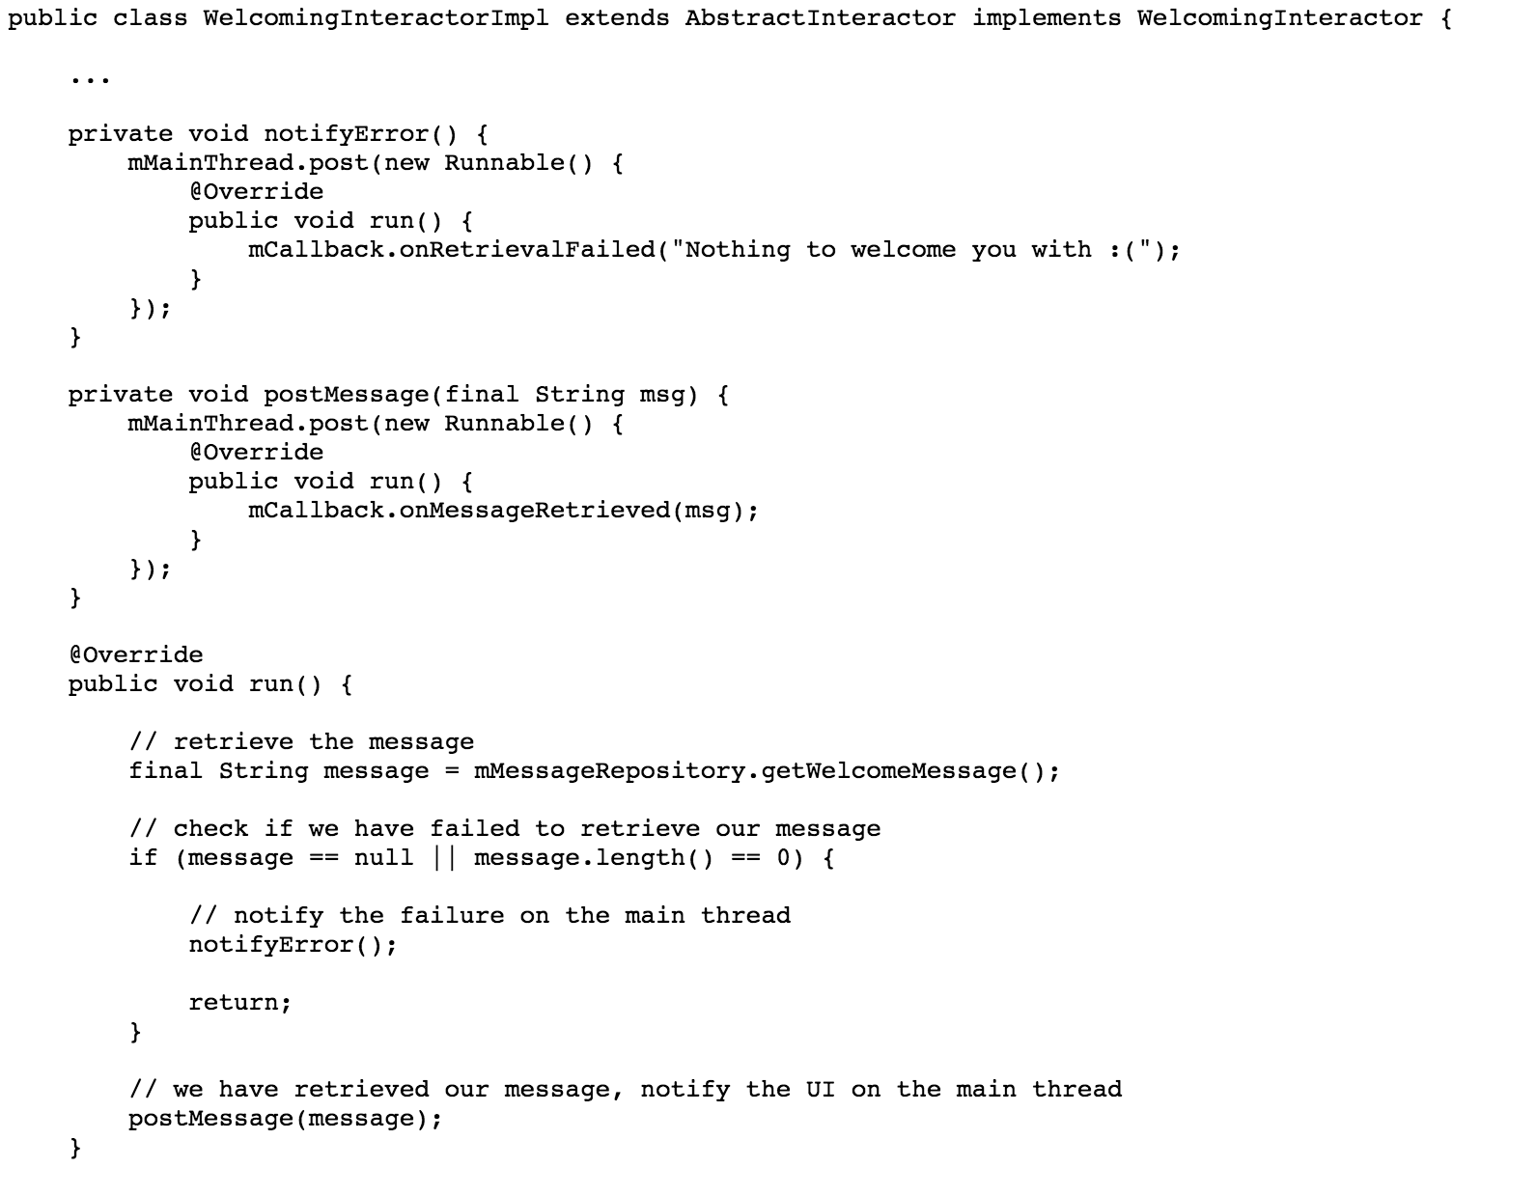
Notes:
Here’s the implementation of the code.
This just attempts to retrieve the message and sends the message or the error to the UI to display it. We notify the UI using our Callback which is actually going to be our Presenter. That is the crux of our business logic. Everything else we need to do is framework dependent.

Slide 59
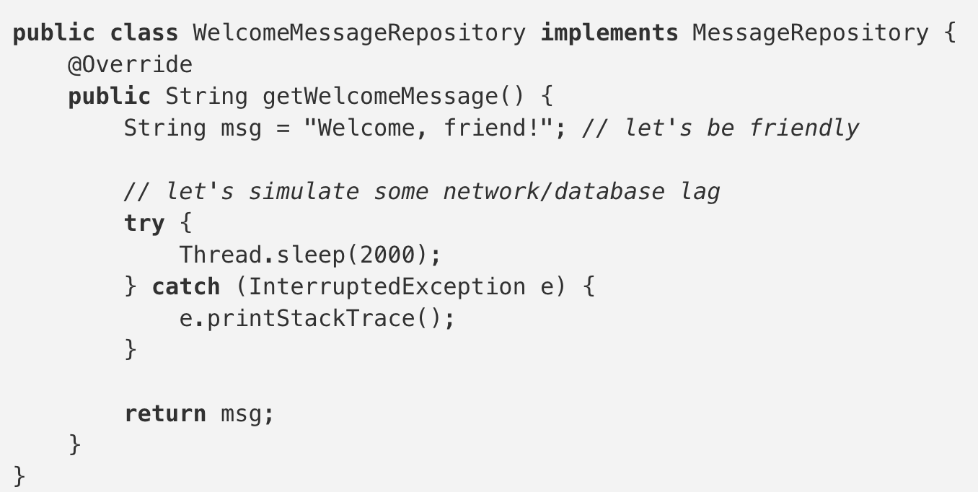
Storage

Slide 60
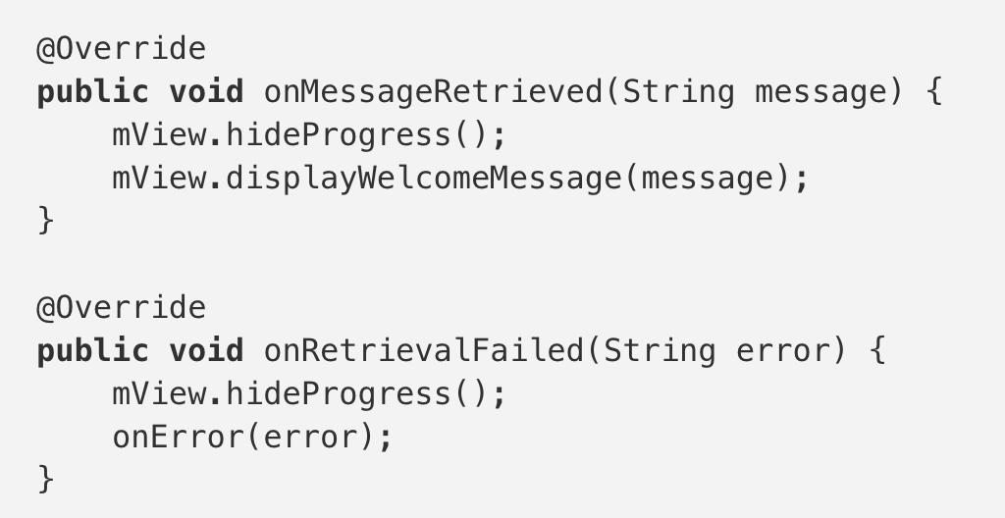
MainPresenter
Notes:
Presentation code belongs to the outer layer in Clean. It consists of framework dependent code to display the UI to the user. We will use theMainActivity class to display the welcome message to the user when the app resumes.
Let’s start by writing the interface of our Presenter and View. The only thing our view needs to do is to display the welcome message:

Slide 61
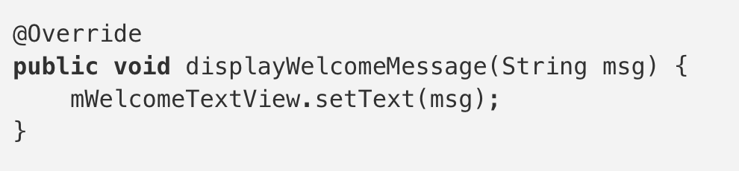
MainActivity

Slide 62
Summary of calls
MainActivity
->MainPresenter
-> WelcomingInteractor
-> WelcomeMessageRepository
-> WelcomingInteractor
-> MainPresenter
-> MainActivity

Slide 63
Summary of calls
Outer — Mid — Core — Outer — Core — Mid — Outer

Slide 64
Thursday
Project Demo (10 mins)
Show features
Talk about what you’re done so far
Talk about plans to complete your app

